Slide 1

IBM Hack
1
Challenge
2022
Knowledge Institute of Technology, Salem
Team Name : The Braniax
Team Members :
Prasanna Sekaran E Sowndarya T
Sree Varshini S

Slide 2
Applying AI & ML to Help people improve their lifestyle
2
Adapted method :
Developing an app ( APP - Braniax ) which constitutes of various models built inside them for the users which helps to improve their lifestyle by using the marvellous concepts of AI & ML

Slide 3
APP - Braniax
3
App-Braniax is developed on Android Studio ( Dolphin ) by Java & Kotlin Programming language, which has series of modules that enhance human beings by improving their lifestyle in an efficient way. The main objective of this app is to make things easy for humans to analyze and understand the complex reasons which further made simpler.
This app consists of the following modules built in them:
Image Classification Object Detection Face Detection Audio Classification
Bird Sound Identification Flower Identification Spam Detector

Slide 4
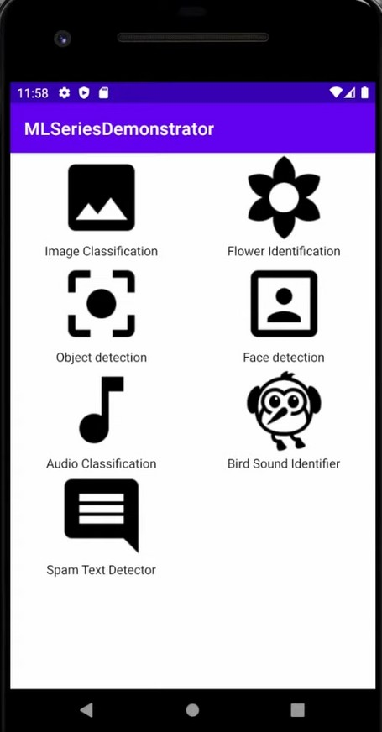
Outline Of the App - Braniax
4

Slide 5
Image Classification :
5
Image Classification classifies the images in around 400 plus labels and produces a concrete output to the user by analyzing the things that are labelled or captured and provides the things that are found on that image.
Flower Identification :
The app relies on the observation of flower images, the user may choose the flower characters that will guide the identification process. Here only datasets of five flowers were given including roses and daises which identifies the color pattern and produces an probability percentage to the user as output by identifying the flower

Slide 6
Face Detection :
6
It can identify the large amount of people in an image and produces an concrete output to the user by the location of their faces with corresponding labelling
Spam Text Detector
Spam Text Detector is custom model built to identify spam comments which the users might be trying to comment or send or post on your app so that you can easily detect them and block them before they comment it

Slide 7
7
Object Detection :
It can identify the large amount of objects in an image and produces an concrete output to the user by the location of their labels with corresponding labelling.

Slide 8
About...
8
In this app, we established five modules where the user can perform various operation on those enlisted modules. These case modules are built with the main concept of Machine
Learning, where it plays a major role in the entire universe. Using ML, the lifestyle of humans are made easier and efficient.
For these marvellous reasons, the App-Braniax was developed.
Each module consists of different algorithm but their main objective is to improve the lifestyle of human and to make it more entertaining and efficient.

Slide 9
Thank You !!!
9

